Slide 1


HTML Tags LIST
Basic Forms

Slide 2
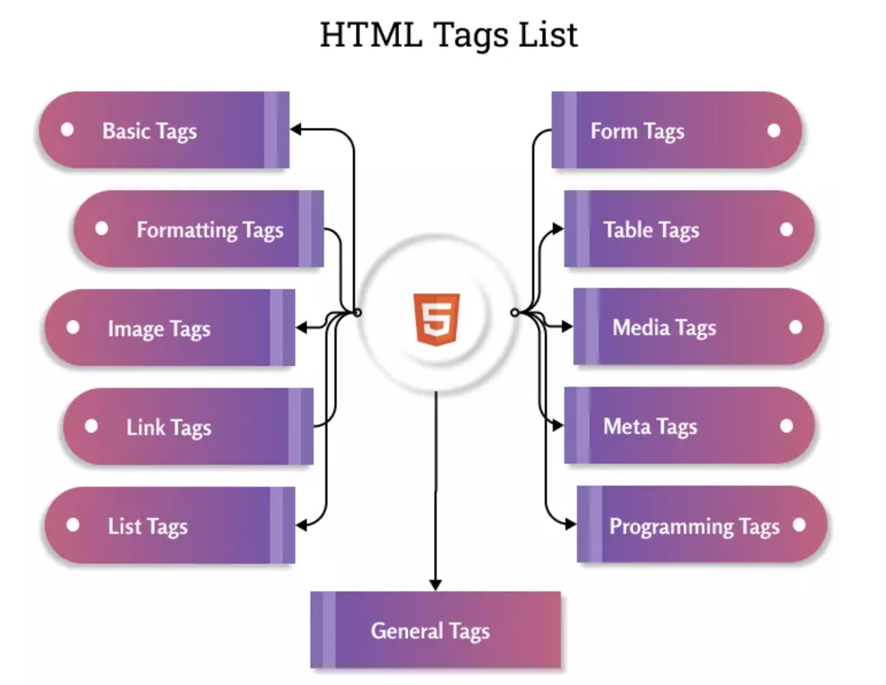

Slide 3
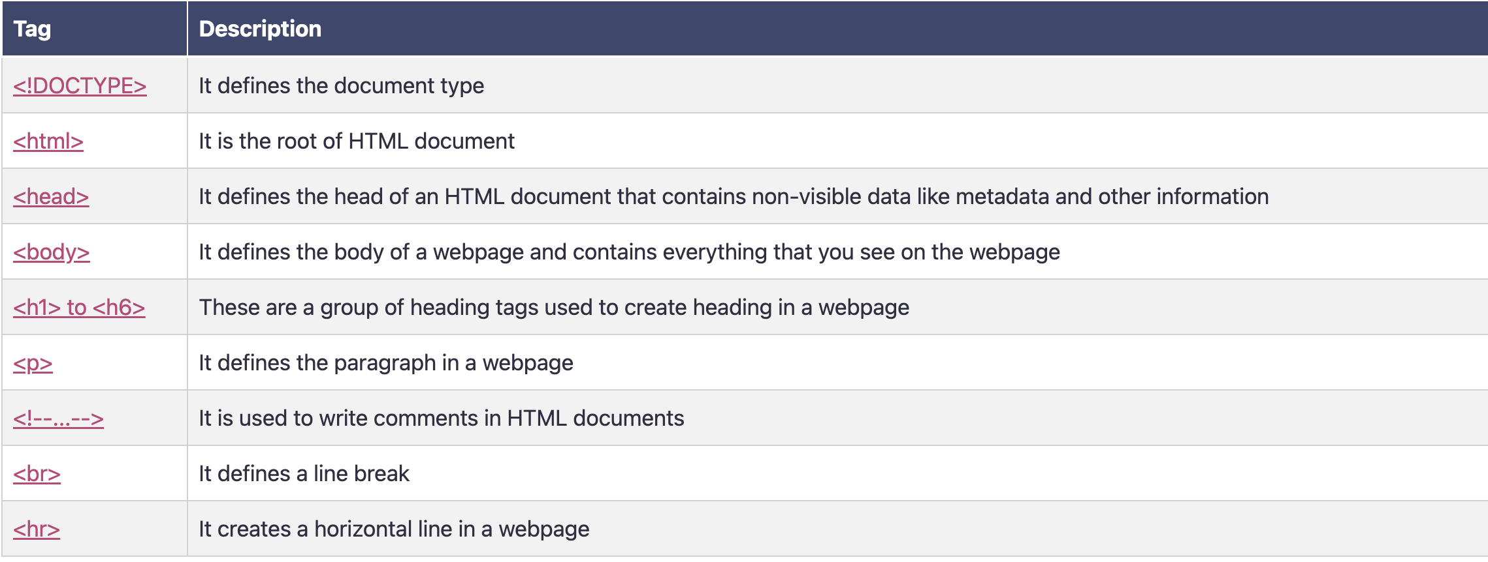
1. HTML Basic Tags

Slide 4
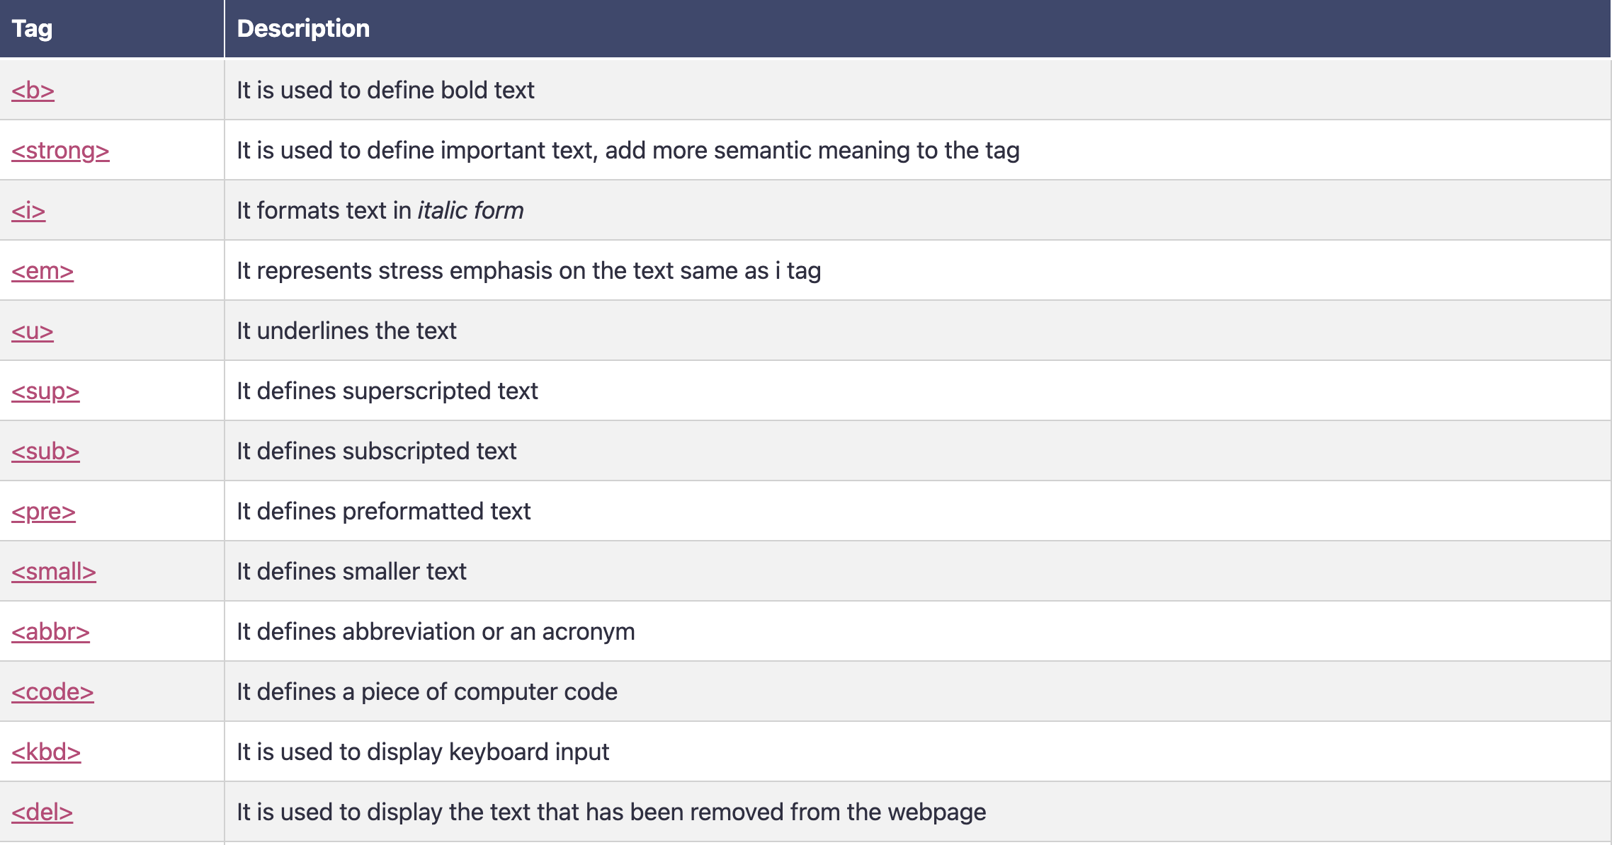
2. Formatting tags
This is a list of formatting tags in HTML5. It gives us the ability to format the text without using CSS.

Slide 5
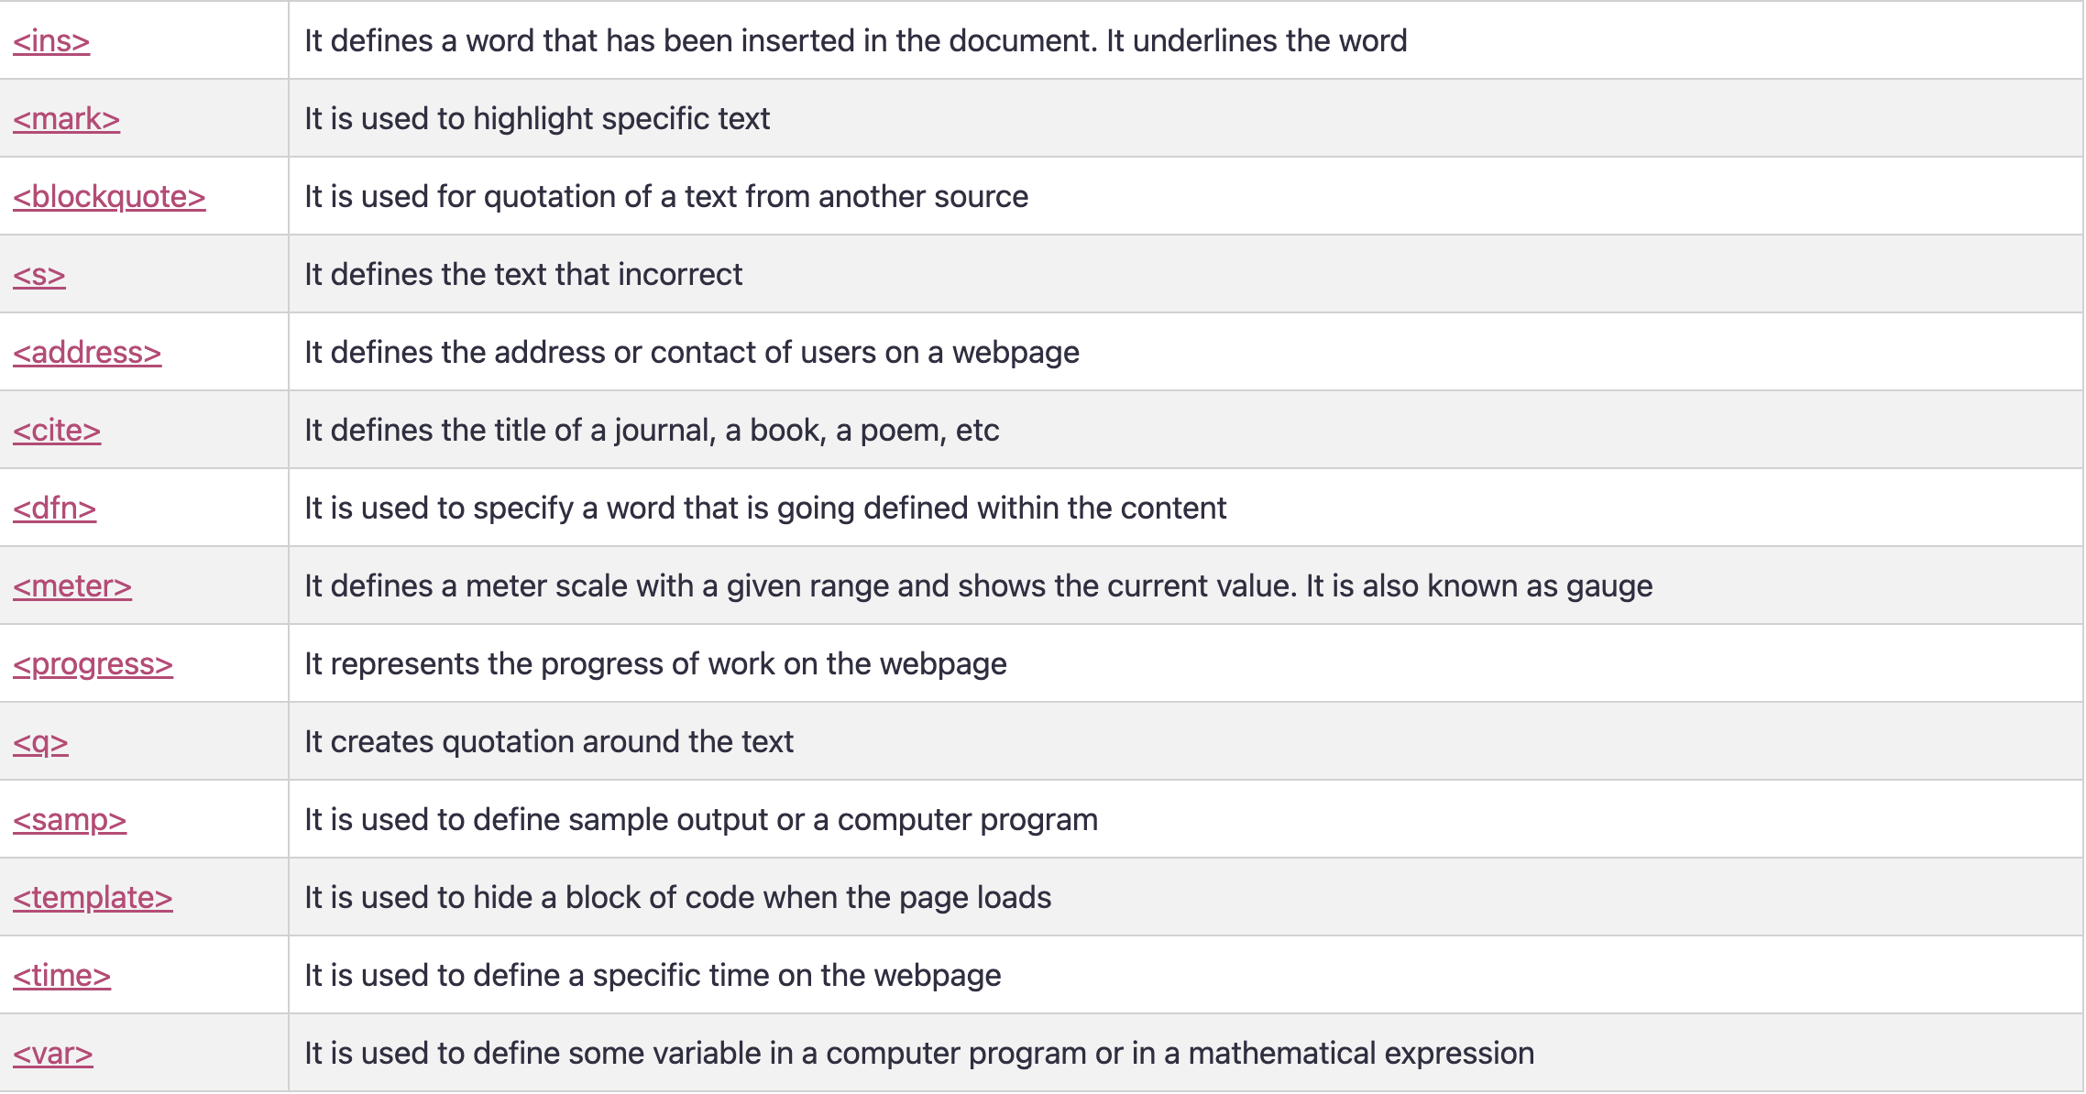

Slide 6
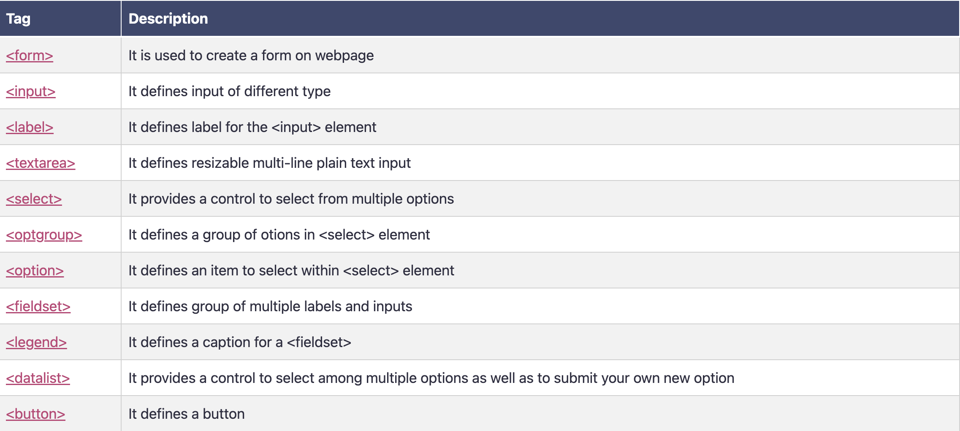
3. Form and input tags

Slide 7
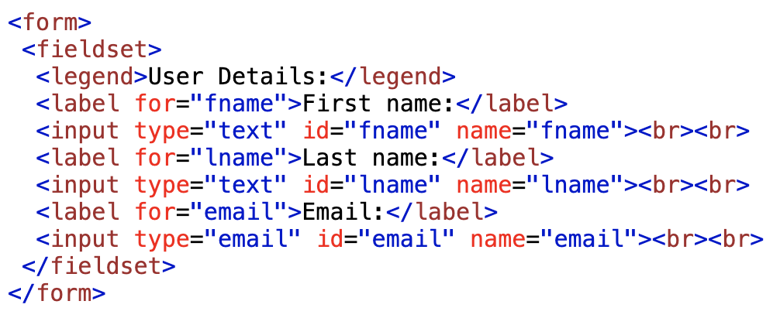
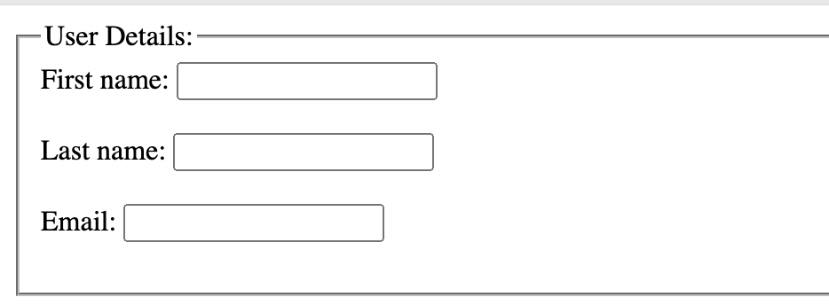
3. Form and input tags

Slide 8

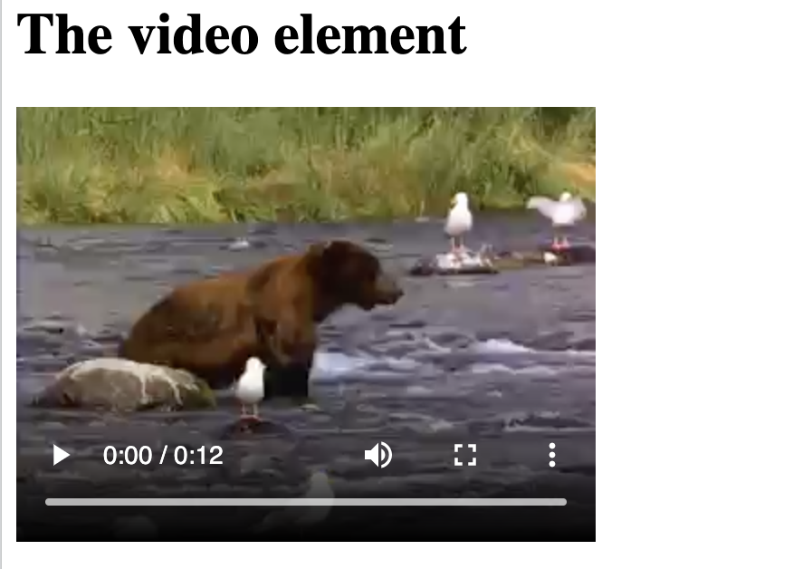


4. Media tags

